Slide 1
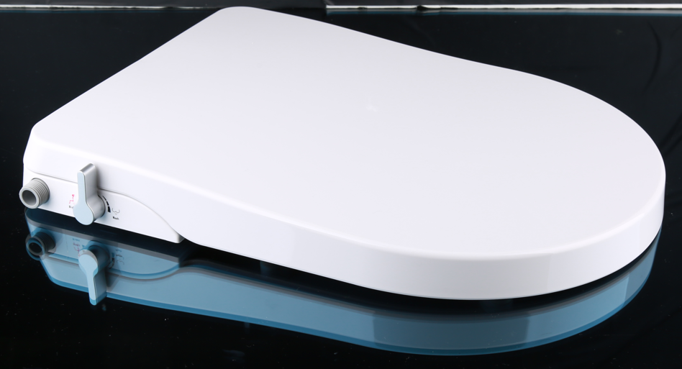
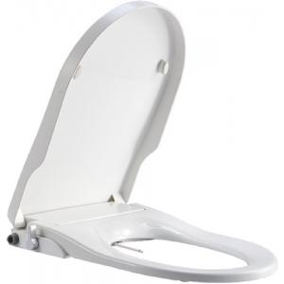
Key Specification
Product Type | Axisse CFB10400-FAST3; CFB10400-ASI2;CL6002E-6D
Standards Criteria | JCT/764
Target Market | Asia
Apply plant | Asia
Seat cover color | AS White II
Seat cover cost FOB | 17.42$
Special structure design | Flush platform in normal base ASSY
Brand/Logo | America Standard
Logo Finishes | Printing ink
Seat / Cover Material | PP
Installation Style | Top installation
Fixing bolts Material | SUS 304
Fxing expansion / Nut | Nylon/PP
Normal / soft closing | Soft closing
Anti-siphon parts for US | NO
Water pressure range | Static pressure: 0.07-0.8MPa, Dynamic pressure: above 0.05Mpa-0.75MPa
Packaging | AS Carton Box
Weight | 2.3kg
Size : length * width *height | 500*383*60mm
Normal/Non-slip bumper | Normal bumper
Product image

